Slide 1
The effect of radiation on our body
20190349 신지호
20200548 장재형

Slide 2
Context
The physical property of radiation
The effect of radiation on our body
Q&A

Slide 3
Two types of radiation
Ionizing radiation
(전리 방사선)
Nonionizing radiation
(비전리 방사선)

Slide 4
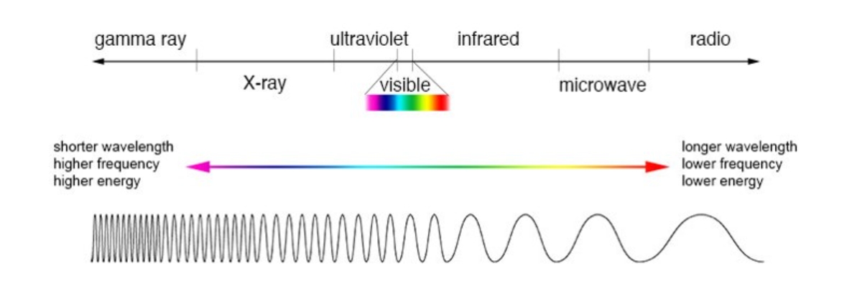
The physical property of radiation
Ionizing radiation (전리 방사선)
Alpha ray
Beta ray
Gamma ray
X ray

Slide 5
The physical property of radiation
Nonionizing radiation (비전리 방사선)
Visible light
Infrared
Microwave
Radio

Slide 6
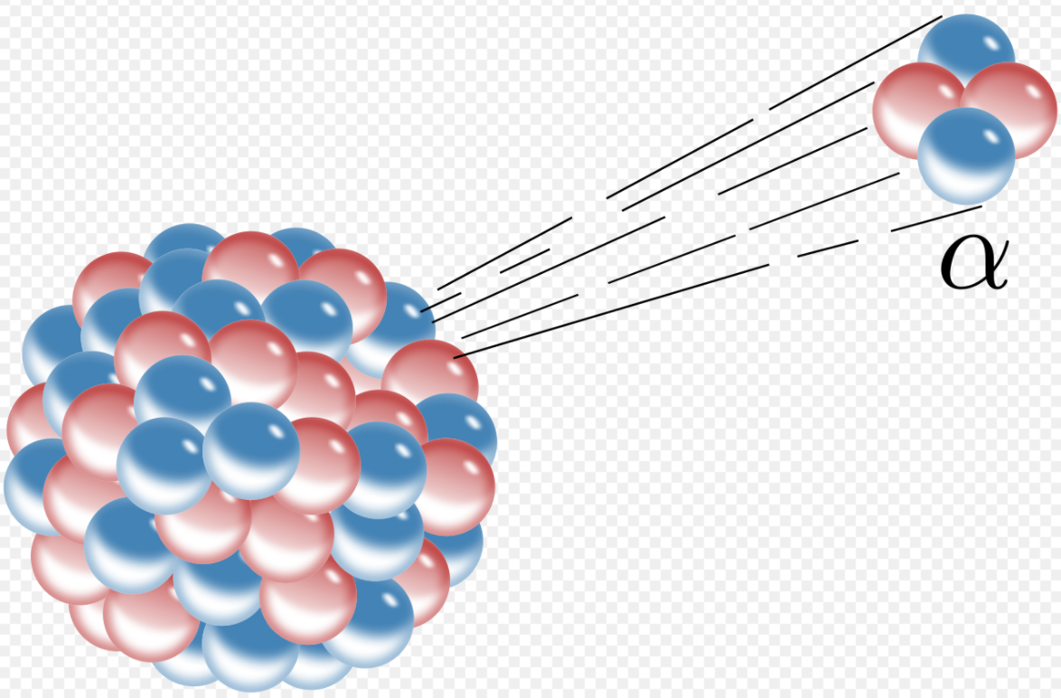
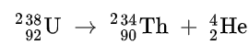
Alpha Ray (He²⁺)
(Alpha Decay)
<property>
- Easily absorbed
- Dangerous if it enters human body
- Used in fire alarm (²⁴¹Am), unsealed source radiotherapy

Slide 7
Unsealed source radiotherapy
injecting radioactive substances called radiopharmaceuticals to treat medical conditions, particularly cancer
Radiopharmaceuticals
Generating Alpha ray : Radium (²²³Ra)
Generating Beta ray : Calcium (⁴⁷Ca), Carbon (¹⁴C), Strontium (⁸⁹Sr)
Generating Gamma ray : Chromium (⁵¹Cr), Indium (¹¹¹In), Iodine (¹²³I)

Slide 8
Beta Ray (e- / e+)
n → p + e- + νe
(Beta- decay)
p → n + e+ + νe
(Beta+ decay)
<property>
- Transmittance : greater than alpha, less than gamma
- Used in beta lightbulb(³H, phosphor), PET scan

Slide 9
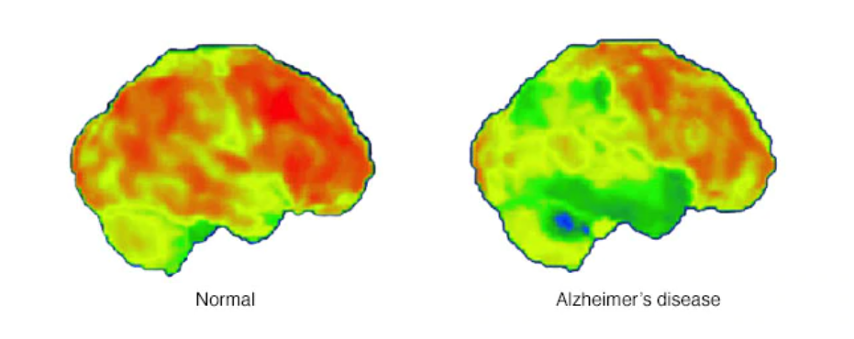
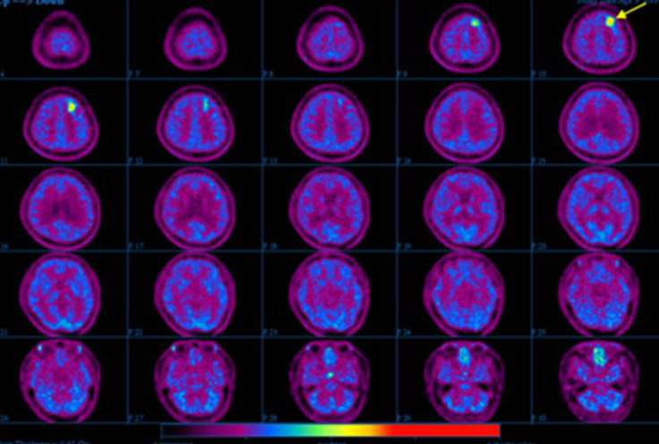
PET (Positron Emission Tomography)
Brain Tumor patient
Glucose digestion speed : Abnormal cells > Normal cells
1. Inject radioactive isotopes (tracer) (F-18-FDG) (F-18-불화디옥시포도당)
2. F-18-FDG moves to abnormal cells
3. Beta+ decay & Pair annihilation at abnormal cells -> create Gamma ray
4. Use Gamma ray detector

Slide 10
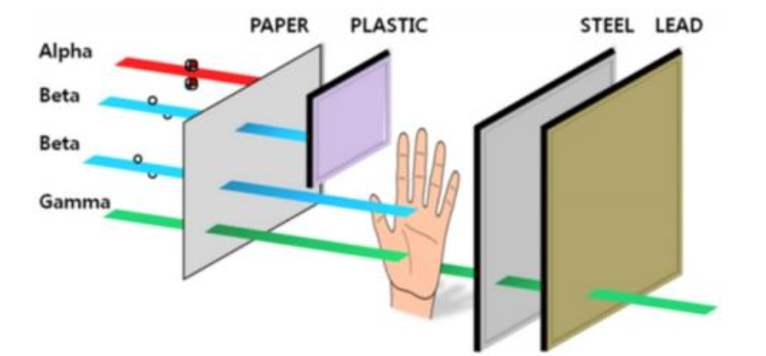
Gamma Ray
Nucleus : proton + neutron
Repelling force between protons, strong nuclear force between proton and neutron
Unstable -> emit gamma ray and become stable
Usage
- Medical equipment sterilization
- Cancer treatment

Slide 11
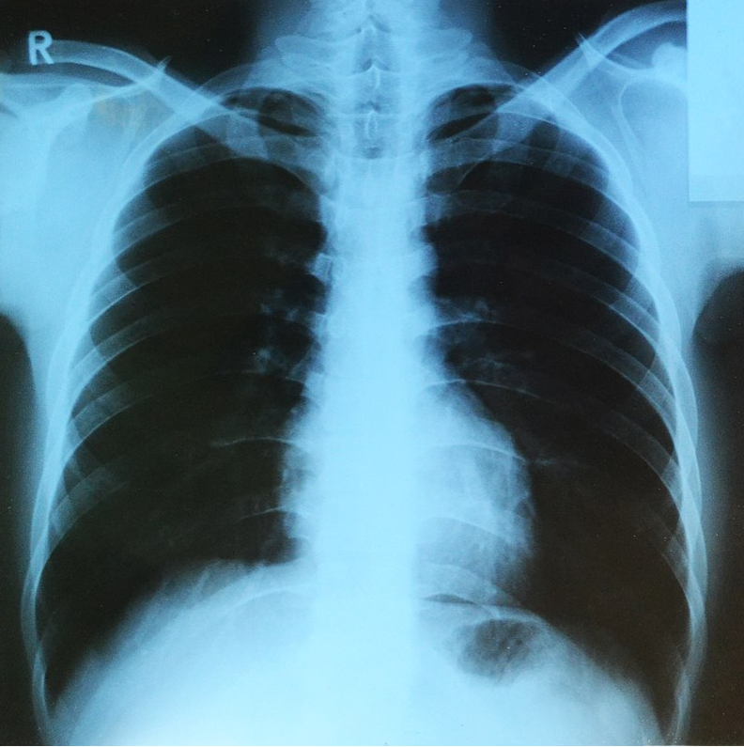
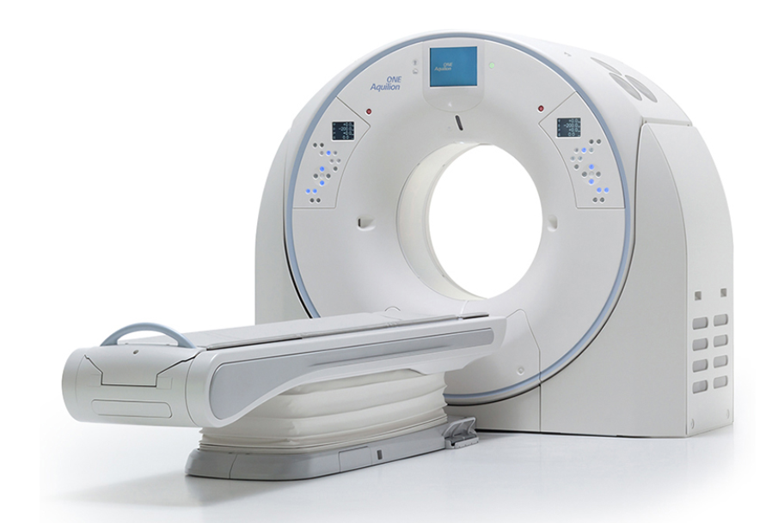
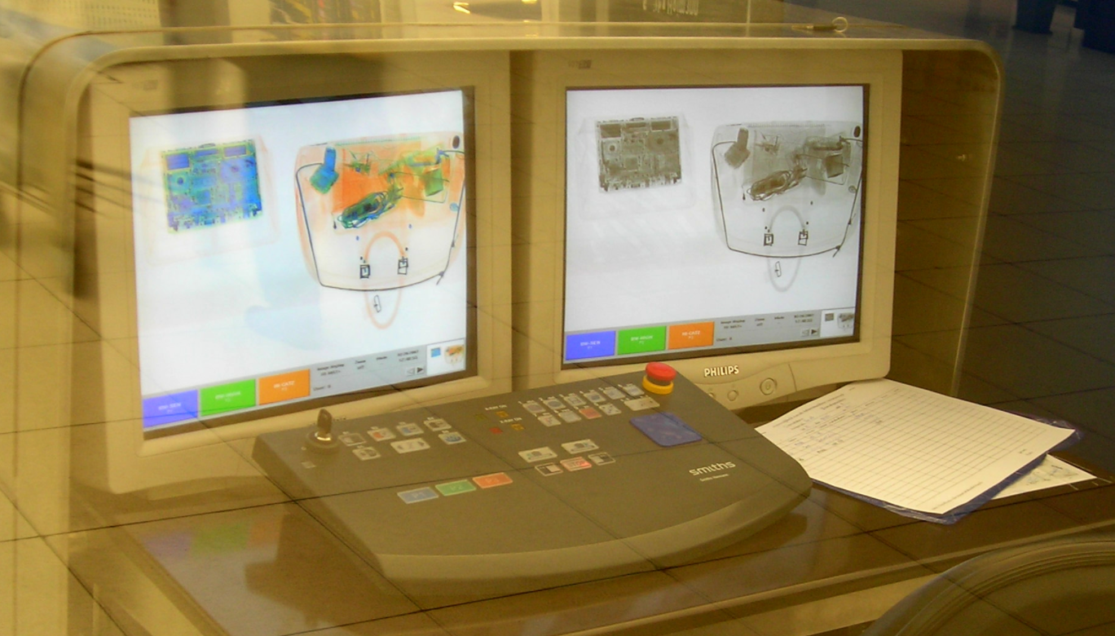
X-Ray
High energy
electron
X-ray
Low energy
X-ray photo
CT (computer tomography)
Luggage screening in airport

Slide 12
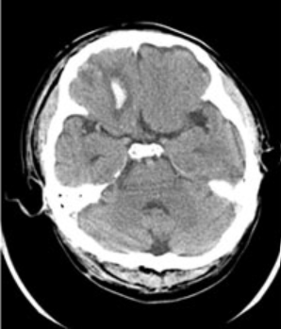
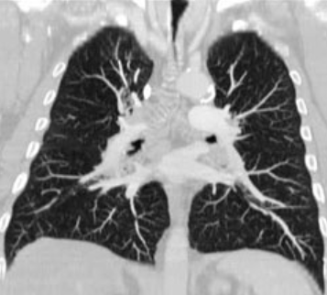
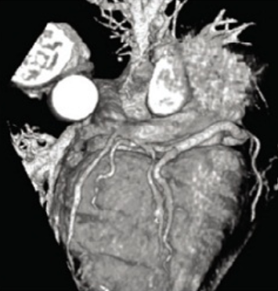
CT (Computer Tomography)
- Transmit X-ray through human body in multiple angles
- X-ray detectors on the other side collect data about transmitted X-ray
- Create an image in 2D or 3D by using computer program
CT (computer tomography)
Brain CT
Chest CT
Heart CT

Slide 13
The effect of radiation on our body

Slide 14

Ionized
Kinetic E
Nonionized

Slide 15
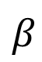
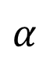

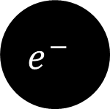
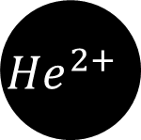
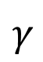
Ionized
Ionized
$$α$$
$$β$$
$$γ$$
$${He}^{2+}$$
$$e^{−}$$
$$γ$$
Concrete
Paper
Aluminum

Slide 16
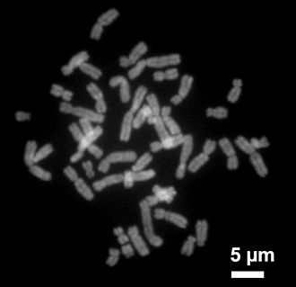
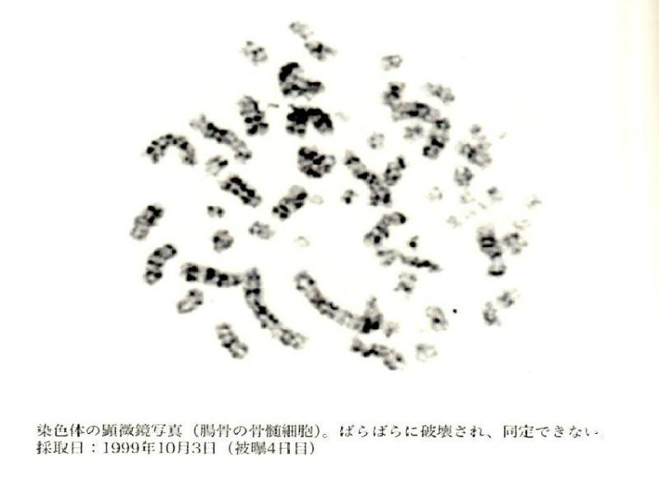
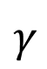

$$γ$$
$$γ$$
Electromagnetic Wave

Slide 17



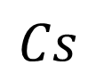
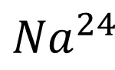



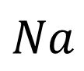

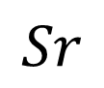


$$Na$$
$${Na}^{24}$$
$$Na$$
$${Na}^{24}$$
$$Sr$$
$$Sr$$
$$I$$
$$Cs$$
$$I$$
$$Cs$$

Slide 18
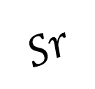
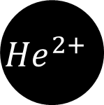






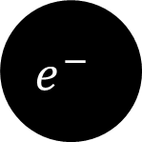
$$e^{−}$$
$$Cs$$
$$Cs$$
$$Sr$$
$$Sr$$
$${He}^{2+}$$
$$I$$
$$I$$
$$γ$$

Slide 19

Kinetic Energy
Cure
Cancer
Cancer
DNA
DNA
Ribosomes
Ribosoems
Enzymes
Enzymes

Slide 20
1
1
Kinetic Energy
AIDS
White Blood Cell
Lymph

Slide 21
2
2
Old
New
Dermis

Slide 22

3
3
No Food
No digestion
Multiple Organ Failure
Multiple Organ Failure
On stomach and Duodenum
On stomach and Duodenum

Slide 23
End
End
Death By
Multiple Organ Failure
Multiple Organ Failure
Heart Attack
Heart Attack

Slide 24
Reference
Reference
https://ko.wikipedia.org/wiki/%EC%97%BC%EC%83%89%EC%B2%B4
https://ko.wikipedia.org/wiki/%EB%8F%84%EC%B9%B4%EC%9D%B4_%EC%B4%8C_%EB%B0%A9%EC%82%AC%EB%8A%A5_%EB%88%84%EC%B6%9C_%EC%82%AC%EA%B3%A0 https://ko.wikipedia.org/wiki/%EA%B8%89%EC%84%B1%EB%B0%A9%EC%82%AC%EC%84%A0%EC%A6%9D%ED%9B%84%EA%B5%B0

Slide 25
Q&A

